Slide 1
Linear Differential Equations
Particular integral

Slide 2

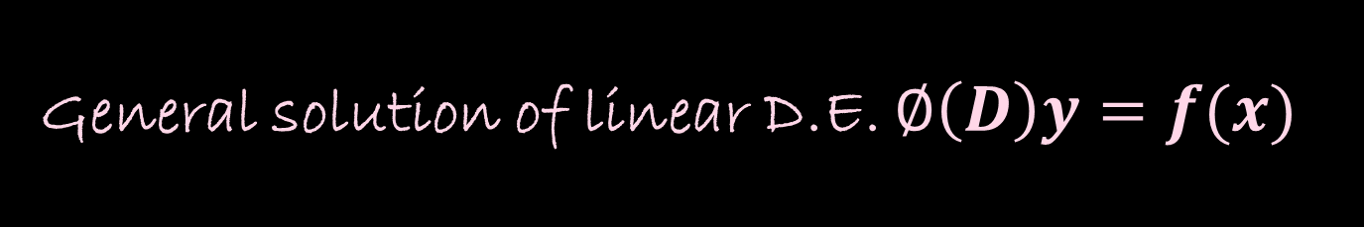
General solution of linear D.E. $∅\left(D\right)y=f(x)$
General solution of linear D.E. $∅\left(D\right)y=f(x)$ The solution of the DE involves two parts. a) Complementary function (CF)
b) Particular integral (PI) We can write it as $y=y_{c}+y_{p}$

Slide 3

Particular integral
P.I.= $y_{p}=\frac{1}{∅\left(D\right)}f(x)$
Example: If $(D^{2}+3D+2)y=e^{e^{x}}$ then
P.I. $=y_{p}=\frac{1}{∅\left(D\right)}f\left(x\right)=\frac{1}{D^{2}+3D+2}e^{e^{x}}$

Slide 4
Methods of obtaining P.I.
There are three methods to find P.I.
General method
Short-cut methods
Method of variation of parameters

Slide 5

General method
This method is useful when short-cut methods are not applicable.
1)$\frac{1}{D−m}f(x)$
P.I. $=y_{p}=\frac{1}{∅\left(D\right)}f\left(x\right)$
$$=\frac{1}{D−m}f\left(x\right)=e^{mx}\int{e^{−mx}}f\left(x\right)dx$$
P.I. $=y_{p}=\frac{1}{D+m}f\left(x\right)=e^{−mx}\int{e^{mx}}f\left(x\right)dx$

Slide 6

Examples
Solve $(D^{2}+3D+2)y=e^{e^{x}}$
Solution: For C.F.,
Consider A.E.= $D^{2}+3D+2=0$
Roots are $D=−1,D=−2$
C.F.$=c_{1}e^{−1x}+c_{2}e^{−2x}$
Here P.I.= P.I. $=y_{p}=\frac{1}{∅\left(D\right)}f\left(x\right)=\frac{1}{D^{2}+3D+2}e^{e^{x}}$
$=\frac{1}{(D+2)(D+1)}e^{e^{x}}=\frac{1}{(D+2)}\left[\frac{1}{(D+1)}\right]e^{e^{x}}=\frac{1}{(D+2)}\left[e^{−x}\int{e^{x}e^{e^{x}}dx}\right]$
Put $e^{x}=t ∴e^{x}dx=dt$
$=\frac{1}{(D+2)}\left[e^{−x}\int{e^{t}dt}\right]$ $=\frac{1}{(D+2)}\left[e^{−x}e^{e^{x}}\right]$ ${=e}^{−2x}\int{e^{2x}{e^{−x}e}^{e^{x}}dx}$
${=e}^{−2x}\int{e^{x}e^{e^{x}}dx=}e^{−2x}e^{e^{x}}$
Hence $y=y_{c}+y_{p}$=$c_{1}e^{−1x}+c_{2}e^{−2x}+e^{−2x}e^{e^{x}}$

Slide 7

Solve $\frac{d^{2}y}{dx^{2}}+\frac{dy}{dx}=\frac{1}{1+e^{x}}$
Solution: ($D^{2}+D)y=\frac{1}{1+e^{x}}$
A.E.$=D\left(D+1\right)=0$
$∴ D=0, D=−1$ are two roots
C.F.$=c_{1}e^{0x}+c_{2}e^{−x}=c_{1}+c_{2}e^{−x}$
P.I.$=y_{p}=\frac{1}{∅\left(D\right)}f\left(x\right)=\frac{1}{D\left(D+1\right)}\left[\frac{1}{1+e^{x}} \right]=\left[\frac{1}{D}−\frac{1}{D+1}\right]\left[\frac{1}{1+e^{x}} \right]$
(By partial fraction)
= $\frac{1}{D}\left(\frac{1}{1+e^{x}}\right)−\frac{1}{D+1}\left(\frac{1}{1+e^{x}}\right)$
$=\int{\frac{1}{1+e^{x}}dx−e^{−x}\int{e^{x}}}\frac{1}{1+e^{x}}dx$ using formula
Put $1+e^{x}=t, e^{x}dx=dt$
$=\int{\frac{e^{x}}{e^{x}(1+e^{x})}dx−e^{−x}\int{e^{x}}}\frac{1}{1+e^{x}}dx$ multiply div by $e^{x}$ for first integration then substitution
$$\int{\frac{dt}{t(t−1)}−e^{−x}\int{\frac{dt}{t}=}}\int{\left(\frac{1}{t−1}−\frac{1}{t}\right)dt}−e^{−x}log⁡(e^{x}+1)$$
$=\log\left(t−1\right)−\log{t}$ $−e^{−x}log⁡(e^{x}+1)$=$\log{e^{x}}−\log\left(1+e^{x}\right)$ $−e^{−x}log⁡(e^{x}+1)$
$=x−$ $−\log\left(1+e^{x}\right)$ $−e^{−x}log⁡(e^{x}+1)$
General solution is $y=y_{c}+y_{p}$=$c_{1}+c_{2}e^{−x}$+ $x−$ $−\log\left(1+e^{x}\right)$ $−e^{−x}log⁡(e^{x}+1)$

Slide 8

Solve, $(D^{2}+3D+2)y=sine^{x}$.
Solution:Consider A.E.= $D^{2}+3D+2=0$
Roots are $D=−1,D=−2$
C.F.$=c_{1}e^{−1x}+c_{2}e^{−2x}$
Here P.I.= P.I. $=y_{p}=\frac{1}{∅\left(D\right)}f\left(x\right)=\frac{1}{D^{2}+3D+2}sine^{x}$
$$=\frac{1}{(D+2)(D+1)}sine^{x}=\frac{1}{(D+2)}\left[\frac{1}{(D+1)}\right]sine^{x}$$
$=\frac{1}{(D+2)}\left[e^{−x}\int{e^{x}sine^{x}dx}\right]$
Put $e^{x}=t ∴e^{x}dx=dt$
$$=\frac{1}{(D+2)}\left[e^{−x}\int{\sin{t}dt}\right]=$$
$\frac{1}{\left(D+2\right)}e^{−x}\left(−cose^{x}\right)=−e^{−2x}\int{e^{−x}\left(cose^{x}\right)}$ again put $e^{x}=t ∴e^{x}dx=dt$
$$=−e^{−2x}sine^{x}$$
Hence $y=y_{c}+y_{p}$=$c_{1}e^{−1x}+c_{2}e^{−2x}+e^{−2x}sine^{x}$

Slide 9

Short-cut Methods for finding P.I.
Case-I: P.I. when $f\left(x\right)=e^{ax}, a is any constant.$
$\frac{1}{∅(D)}e^{ax}=\frac{1}{∅(a)}e^{ax}$ provided $∅(a)≠0$
Case of failure: If $∅\left(a\right)=0$then
P.I.$=x\frac{1}{∅^{′}(a)}e^{ax}$ provided $∅^{′}(a)≠0$
If $∅^{′}\left(a\right)=0$ then
P.I.$=x^{2}\frac{1}{∅^{′′}(a)}e^{ax}$ provided $∅^{′′}(a)≠0$

Slide 10

Example: Find the general solution of $(D^{2}−5D+6)y=3e^{5x}$.
Solution:
($D^{2}−5D+6)y=0$
A.E. $D^{2}−5D+6$ = 0
$$∴D=3 and D=2$$
$y_{c}=C_{1}e^{3x}$+$C_{2}e^{2x}$
P.I. $=y_{p}=\frac{1}{∅\left(D\right)}f\left(x\right)=\frac{1}{D^{2}−5D+6}3e^{5x}$
Here $∅(5)≠0$ by case-I
$$y_{p}=\frac{1}{∅\left(D\right)}f\left(x\right)=\frac{1}{D^{2}−5D+6}3e^{5x}=\frac{3e^{5x}}{5^{2}−25+6}=\frac{e^{5x}}{2}$$
General solution is $y=y_{c}+y_{p}$=$c_{1}e^{3x}+c_{2}e^{2x}$+$\frac{e^{5x}}{2}$

Slide 11

Find general solution of $\frac{d^{2}y}{dx^{2}}+4\frac{dy}{dx}+3y=e^{−3x}$
Solution: here ($D^{2}+4D+3)y=0$
A.E. $D^{2}+4D+3$ = 0
$$∴D=−3 and D=−1$$
$y_{c}=C_{1}e^{−3x}$+$C_{2}e^{−x}$
P.I. $=y_{p}=\frac{1}{∅\left(D\right)}f\left(x\right)=\frac{1}{D^{2}+4D+3}e^{−3x}$
Here $∅\left(D\right)=$ $D^{2}+4D+3$ but $∅\left(−3\right)=$ ${(−3)}^{2}+4\left(−3\right)+3=0$ and case I fails.
$∅^{′}(D)=$2D+4 $∅^{′}\left(−3\right)=2\left(−3\right)+4=−2≠0$
P.I.=$x\frac{1}{∅^{′}(a)}e^{ax}$ provided $∅^{′}(a)≠0$
=$x\frac{1}{∅^{′}(−3)}e^{−3x}$ provided $∅^{′}(−3)≠0$ P.I.=$\frac{xe^{−3x}}{2}$
General solution is
$y=y_{c}+y_{p}=C_{1}e^{−3x}$+$C_{2}e^{−x}+\frac{xe^{−3x}}{2}$

Slide 12
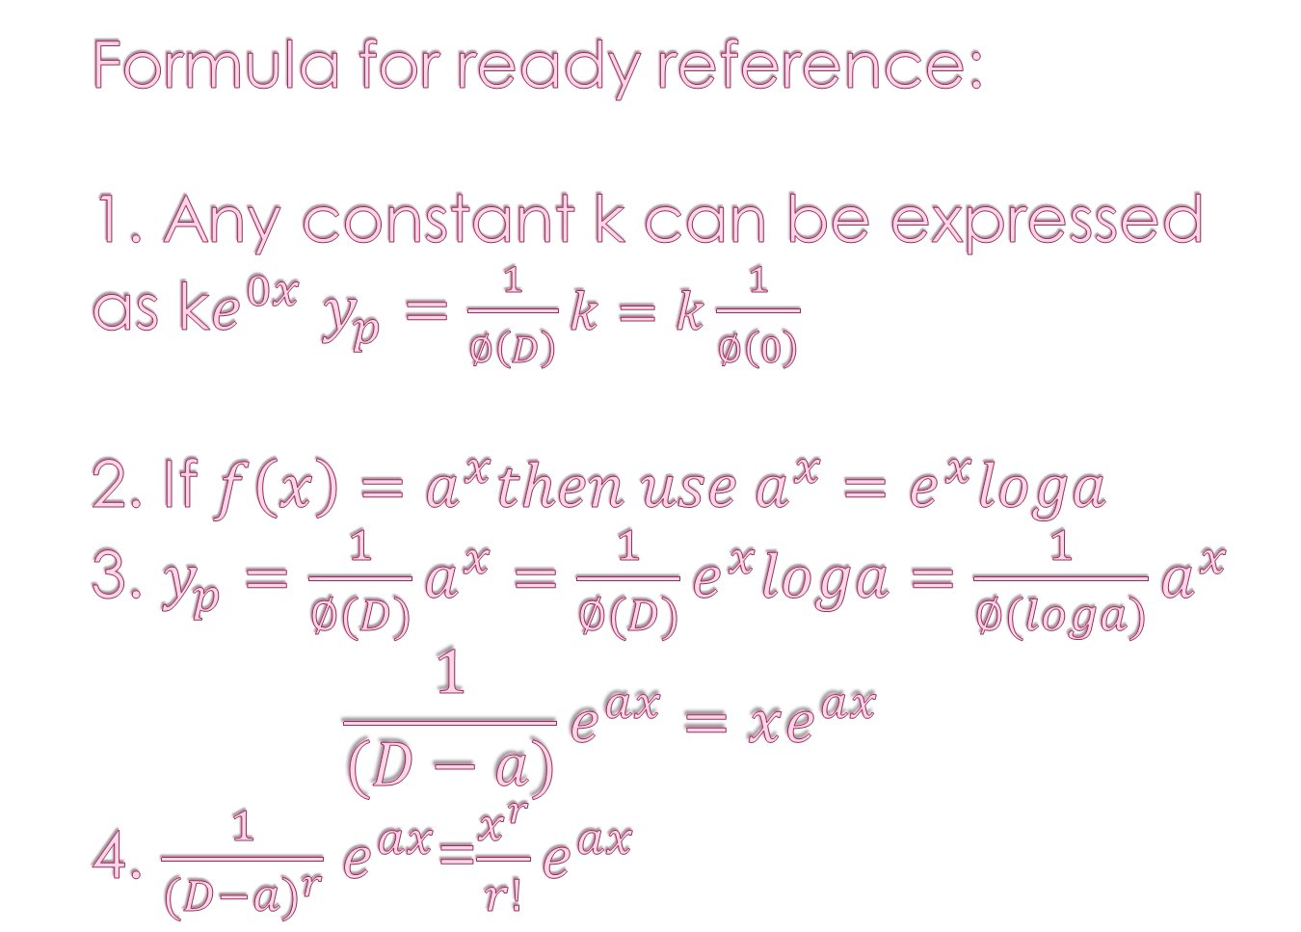
Formula for ready reference: 1. Any constant k can be expressed as k$e^{0x}$ $y_{p}=\frac{1}{∅\left(D\right)}k=k\frac{1}{∅\left(0\right)}$ 2. If $f\left(x\right)=a^{x}then use a^{x}=e^{x}loga$ 3. $y_{p}=\frac{1}{∅(D)}a^{x}=\frac{1}{∅(D)}e^{x}loga=\frac{1}{∅(loga)}a^{x}$ $$\frac{1}{(D−a)}e^{ax}=xe^{ax}$$ 4. $\frac{1}{{(D−a)}^{r}}$ $e^{ax}$=${\frac{x^{r}}{r!}e}^{ax}$

Slide 13

Example: Find general solution of ${\left(D−1\right)}^{3}y=e^{x}+2^{x}−\frac{3}{2}.$
Solution: To find C.F.
Consider A.E. ${\left(D−1\right)}^{3}=0$
Roots are 1,1,1
C.F. ${=y}_{c}=(c_{1}+c_{2}x+c_{3}x^{2})e^{x}$
P.I.=$\frac{1}{{\left(D−1\right)}^{3}}(e^{x}+2^{x}−\frac{3}{2}$) =$\frac{1}{{\left(D−1\right)}^{3}}e^{x}+\frac{1}{{\left(D−1\right)}^{3}}2^{x}\text{+}\frac{1}{{\left(D−1\right)}^{3}}(−\frac{3}{2})$
$=\frac{x^{3}}{3!}e^{x}+\frac{1}{{\left(log2−1\right)}^{3}}2^{x}−\frac{3}{2}\frac{1}{{\left(0−1\right)}^{3}}$
=$\frac{x^{3}}{6}e^{x}+\frac{1}{{\left(log2−1\right)}^{3}}2^{x}+\frac{3}{2}$

